Slide 1









TIDY TASK:
TASK REMINDER AND ORGANIZER
By : Madera & Madriaga

Slide 2

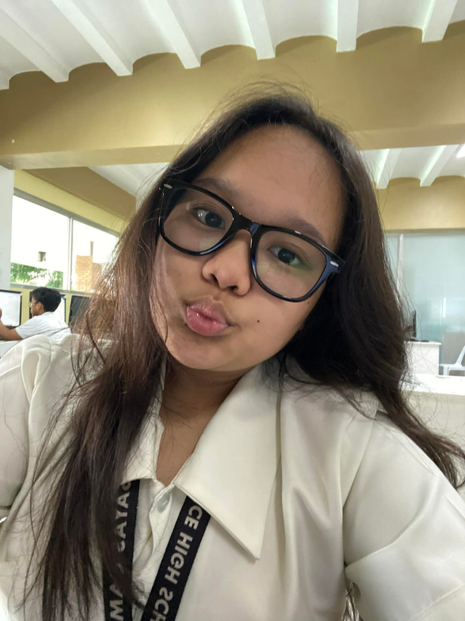
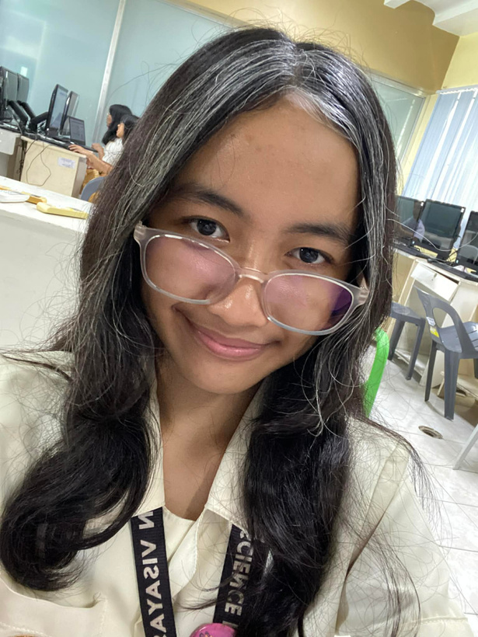
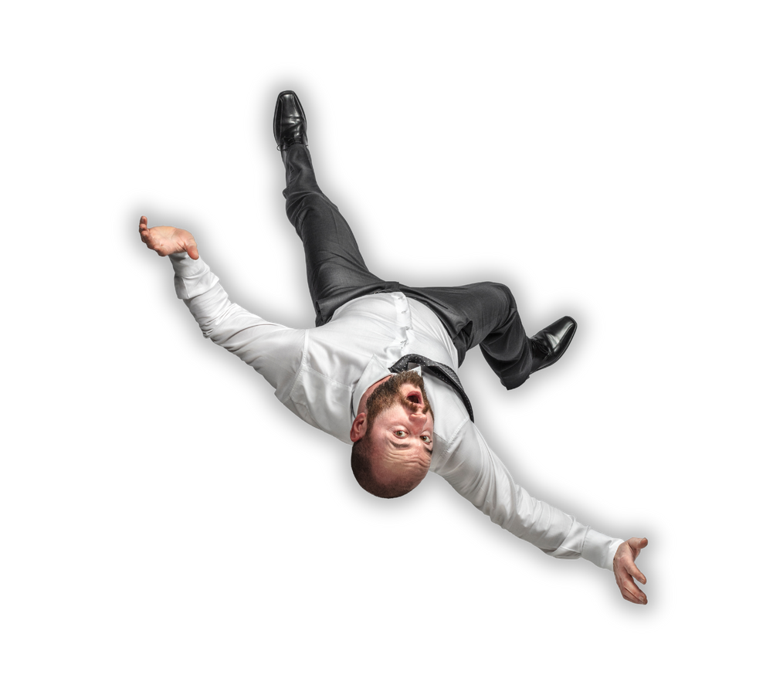
OUR TEAM
Madera, Nadia
Madriaga, Ian

Slide 3

TABLE OF CONTENTS
Problem Statement .................................................. page 4
Objectives .................................................................... page 5-6
Features ........................................................................ page 7
Example Output ........................................................ page 8-9
Flow Chart ................................................................... page 10-11

Slide 4

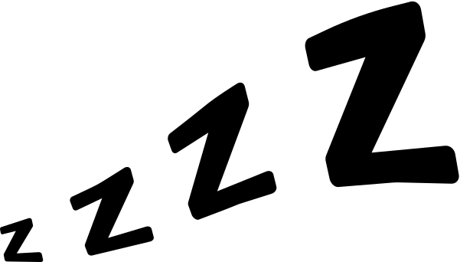
PROBLEM STATEMENT
Many students struggle to balance their academic work, extracurricular activities, and personal responsibilities. Without an organized system for managing daily tasks, they often miss deadlines and lose productivity.
This project aims to solve this problem by creating a task reminder and organizer website/program that helps users organize their schedules, set priorities, and manage their time effectively.

Slide 5

OBJECTIVES
To design and develop a user-friendly reminder website/program that allows users to add, edit, and track tasks and events efficiently.
To create an intuitive and visually simple task-organizing website/program that helps students manage their responsibilities efficiently by allowing them to add, modify, and track daily tasks with minimal steps.
To implement a lightweight and reliable task manager that can store, search, and filter tasks quickly, ensuring smooth performance even as the number of tasks increases.

Slide 6
OBJECTIVES
To promote better time management and productivity among students, aligning with educational goals of discipline and responsibility.
To finalize and present the completed project by the end of the 4th quarter, following scheduled phases for design, development, and refinement.
To complete the development and testing of the website/program within the school year using accessible tools such as Python with Programiz.

Slide 7

FEATURES
Task Manager – Allows users to add, edit, and delete their daily tasks. Each task can include a title, description, and due date.
Task Editing and Updating – Enables users to modify existing tasks if deadlines or priorities change.
Search and Filter Function – Lets users find tasks by keywords, categories, or dates for easy navigation.

Slide 8
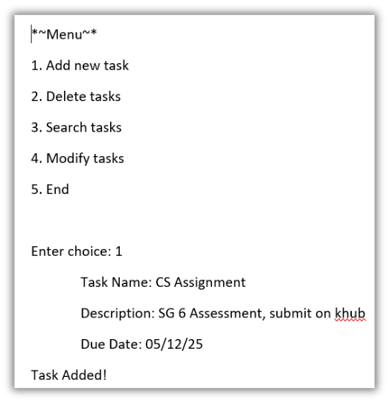
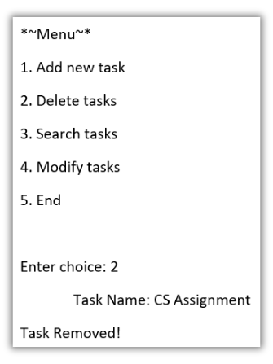
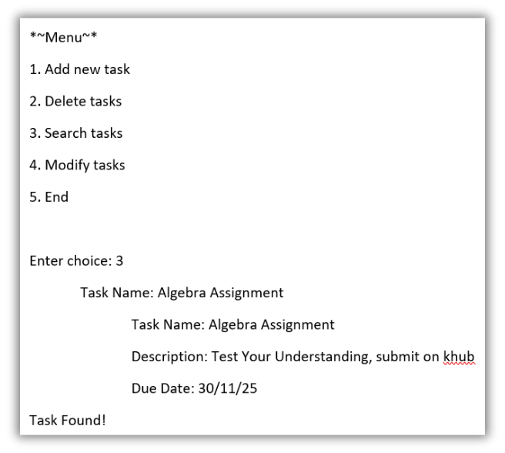
EXAMPLE OUTPUT

Slide 9
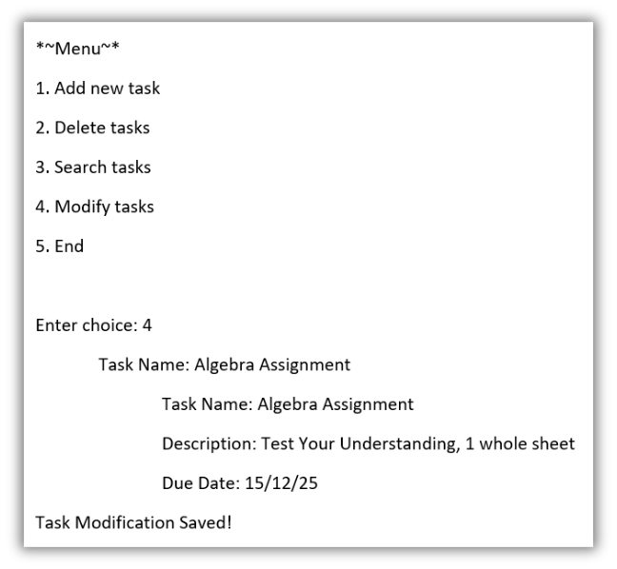
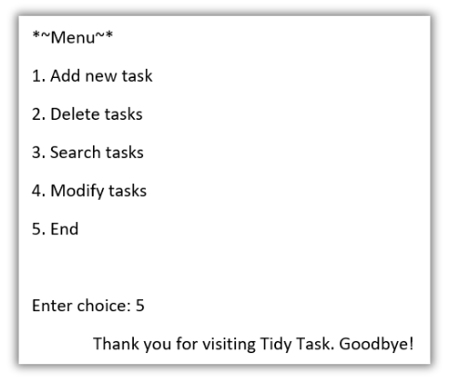
EXAMPLE OUTPUT

Slide 10
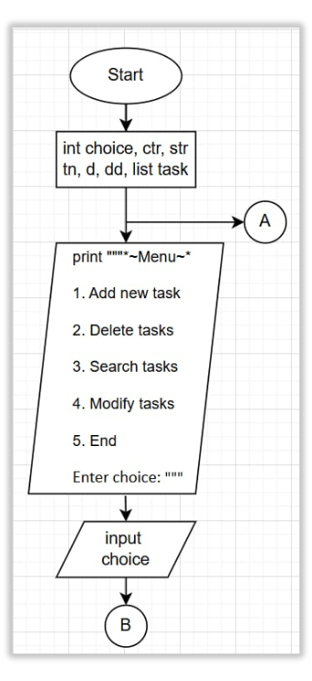
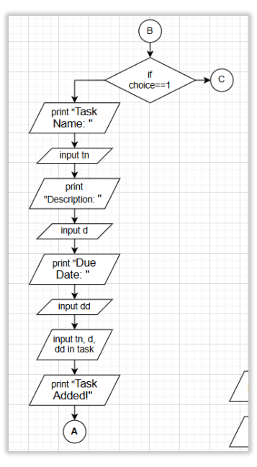
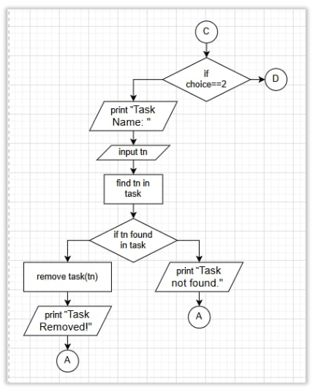
FLOW CHART

Slide 11
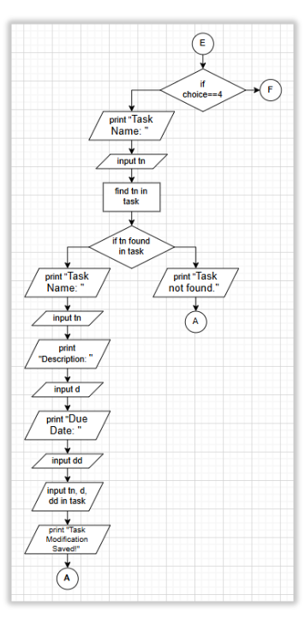
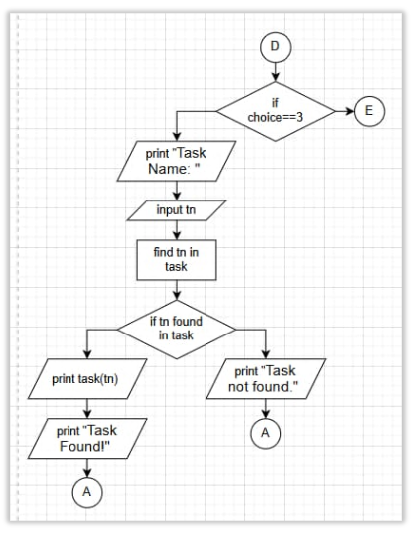
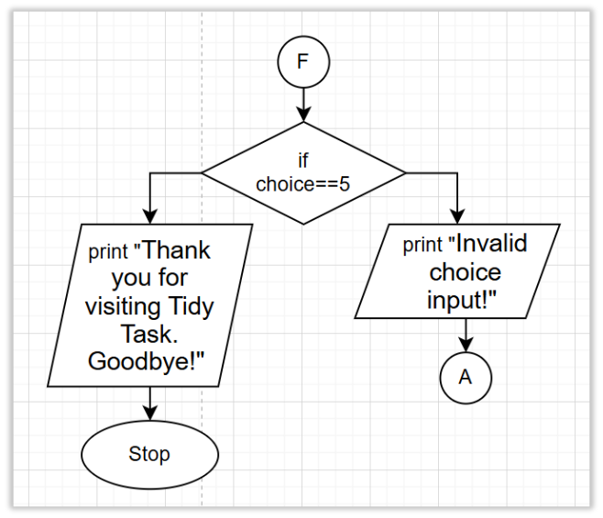
FLOW CHART

Slide 12

THANK
YOU!!

